Slide 1


Exploring ESG Sentiment and Financial Performance
Group: Codeconomics
Yuanhan Cui
Yu Hui Zhicheng You Jiale Zhou

Slide 2
Content
01 Introduction
02 Data Collection
03 Sentimental Analysis
04 Regression &Visualization

Slide 3



01
INTRODUCTION

Slide 4




RESEARCH QUESTION
How does overall sentiment within ESG disclosures correlate with financial performance?
Does sentiment within each ESG component (Environmental, Social, Governance) correlate with financial performance?
Does investor confidence mediate the relationship between ESG sentiment and financial performance?
Notes:
Q1: considering - easy manipulate ESG content / whether positive disclosures serve as genuine indicators of corporate health or act as a tool for the company to conceal its underlying issues to fool investor
Secondly, we delve into the sentiments expressed within each ESG component to discern their individual impact on fi- nancial performance, thereby uncovering the differential influence of environmental, social, and governance factors. Lastly, we propose investor confidence as the mediating link that channels the effects of ESG sentiments to financial performance, offering a deeper under- standing of how perceptions shaped by ESG reporting translate into economic outcomes.

Slide 5
SOCIAL SCIENCE RELEVANCE
UNDERSTANDING CORPORATE INFLUENCE
ANALYZING INVESTOR BEHAVIOR
INFORMING POLICY AND REGULATION
Provides insights into how corporations communicate their roles and responsibilities in economic, environmental, and social spheres through ESG disclosures.
Offers a deeper understanding of corporate behavior, shedding light on alignment with societal values and norms.
Examines how investors incorporate ESG information into their decision-making processes, influencing market dynamics.
Highlights the evolving nature of investment strategies, reflecting changing societal attitudes towards sustainability and governance.
Offers empirical evidence to guide policy discussions on transparency, accountability, and sustainability in the corporate sector.
Contributes to the development of effective regulatory frameworks, promoting responsible corporate practices and market integrity.
Notes:
Three entities: corporate/investor/regulator
Provide insights for these three entities and is conducive to a healthy financial system

Slide 6
02
Data Collection

Slide 7





Data Source
Direct filtered and download financial performance indicator data (ROE, Total Asset, Solvency ratio) from Orbis database: https://login.bvdinfo.com/R1/Orbis;
Scrapped ESG content used for sentiment analysis from financial report：EDGAR filing - 10K annual financial report: https://www.sec.gov/edgar/searchedgar/companysearch
Time period：2023 & 2022

Slide 8
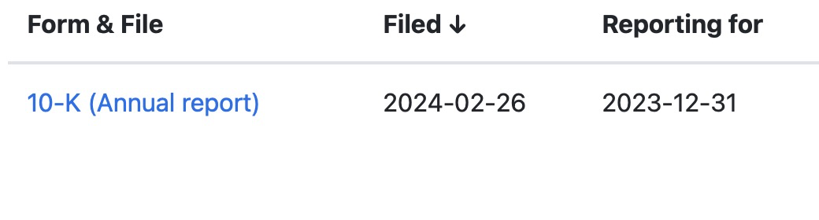
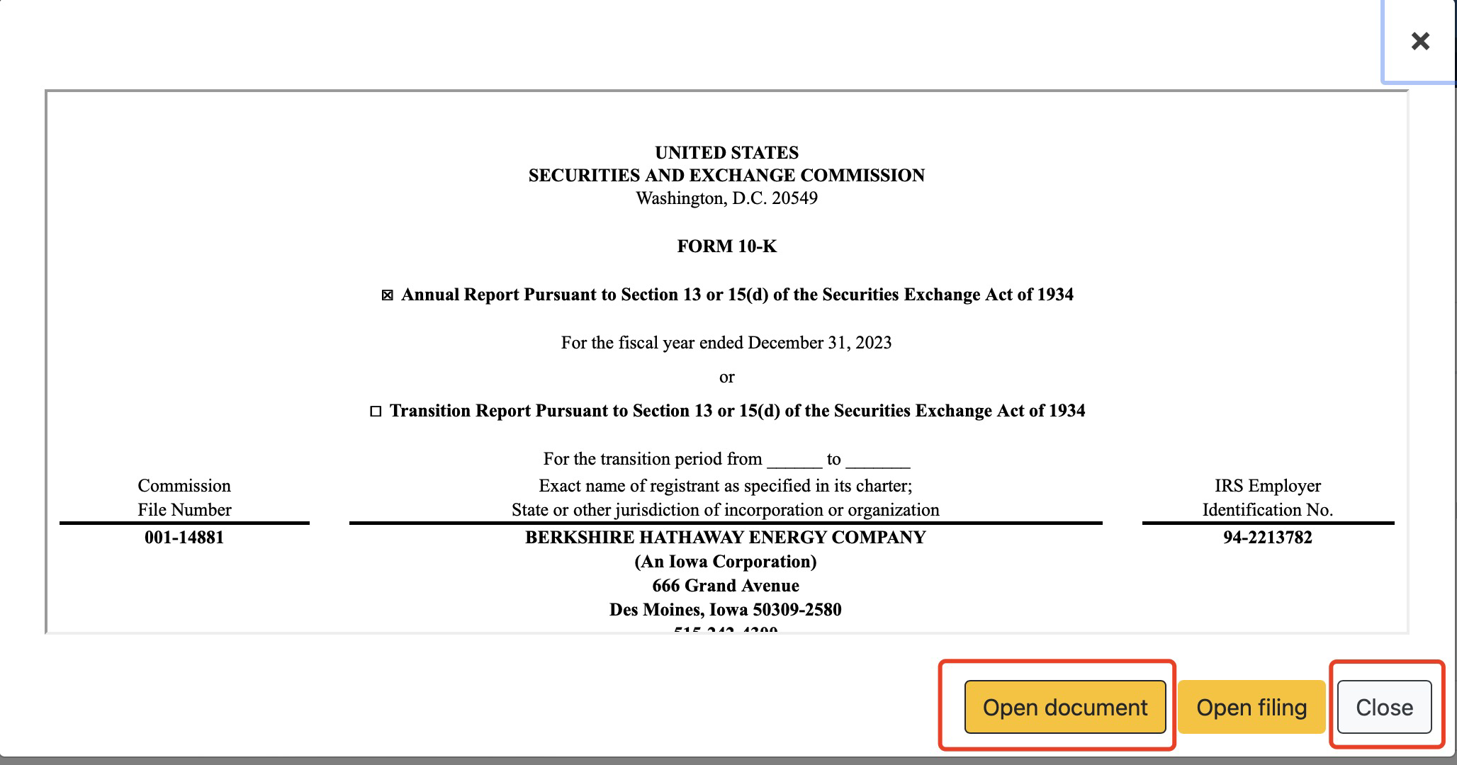
Data collection process : dynamic scrapping
Scrap dynamically: We need to click on certain buttons before reach the report we aim to scrape .
1. preview button
2. popped up preview
3. wait it to load
selenium
4.click open button
5. click close button for preview window
6. click on next page (if we have already scrapped all the report urls in current page, and stop if there is no next page available.)
Notes:
The main difficulties is related to data scrapping. Although the financial report in Edgar websites is in html format, which is scrapable, to access the financial report we need to click on certain buttons. For each report, firstly we need to click on preview button, then in the popped up preview page we need wait it to load and click open button. Also, we need to click close button for preview and click on next page if we have already scrapped all the report in current page, and stop if there is no next page available. Thus we need to scrap dynamically. That is why we use selenium to scrape. Our formal step is firstly scrap all the urls of preview button for each report, then we click on each preview button, get the url link for each open file button, and close the preview window. Here is a short video of scrapping using selenium.

Slide 9
Data collection process : soup and retrieve ESG content
Use request and beautiful soup to collect and soup report content
Check if there is any words related to ESG in each sentence of financial report(We have built an ESG word dictionary that helps us to screen the words )
If there is, we store this sentence to our ESG content dictionary for each company.
For data in Obris, we collected financial data of 10529 companies in the US as of 2023 (we added filter conditions including public limited companies, with size classifications as very large, and are still active in the market).
For ESG content in Edgar, we finally collected data from 8517 companies that release financial reports last year.
Notes:
Finally, we get a list of urls for each companies’financial report. We use request and beatiful soup package access and soup each page content for each url, and check if there is any words related to esg in each sentence of financial report. (We have build a esg word dictionary that helps us to screen the words ).If it is, we store this sentence to our esg content dictionary for each company.

Slide 10
Data cleaning and wrangling
Remove rows that contains NA values in financial metrics data
Data cleaning and matching
Matching data: CIK number as identifier
Process esg string data by by removing punctuation, special characters, and stopwords
Notes:
we try to collect data from both resources and match them. There is also a difficulty with matching the data from orbis to data from edgar. We want a unique and distinct company identifier to match the data from two source. Fortunately, we find the CIK number in both database. The CIK number also helps us in identifying the buttons for scrapping, as each company’s button have the CIK number under certain class that made us easy to identify button for each company.
After matching two dataset, we get 1249 companies data. We then remove the na values in the financial metrics data and process esg string data by by removing punctuation, special characters, and stopwords. and get 1153 companies data of financial metrics and esg content.

Slide 11
03
Sentimental Analysis

Slide 12
Data Analysis - Overview
Sentiment Analysis
Regression
A set of four regression equations
respectively to investigate potential mechanism
Get the sentiment score
for the regression equation.

Slide 13
Sentimental Analysis
Sentiment Analysis
A supervised training model was employed. The implementation methodology can be broken down into the following key steps:
1. Employ the positive and negative words dictionary (LM dictionary).
2. Build the ESG dictionaries (one for each category: environmental, social, governance).
3. Utilizing a three-sentence moving window identify all instances of environmental, social, and governance discussions.
4. Count the total number of words that are positive and negative. By subtracting the number of negative words from the number of positive words, derive the total "points" for the given ESG category.
5. For each file, derive the total ESG points by aggregating the total points for each ESG category.
6. Normalization for Cross-File Comparison: we normalizes the total points by the total number of sentiment words within each document to convert the score into a percentage

Slide 14
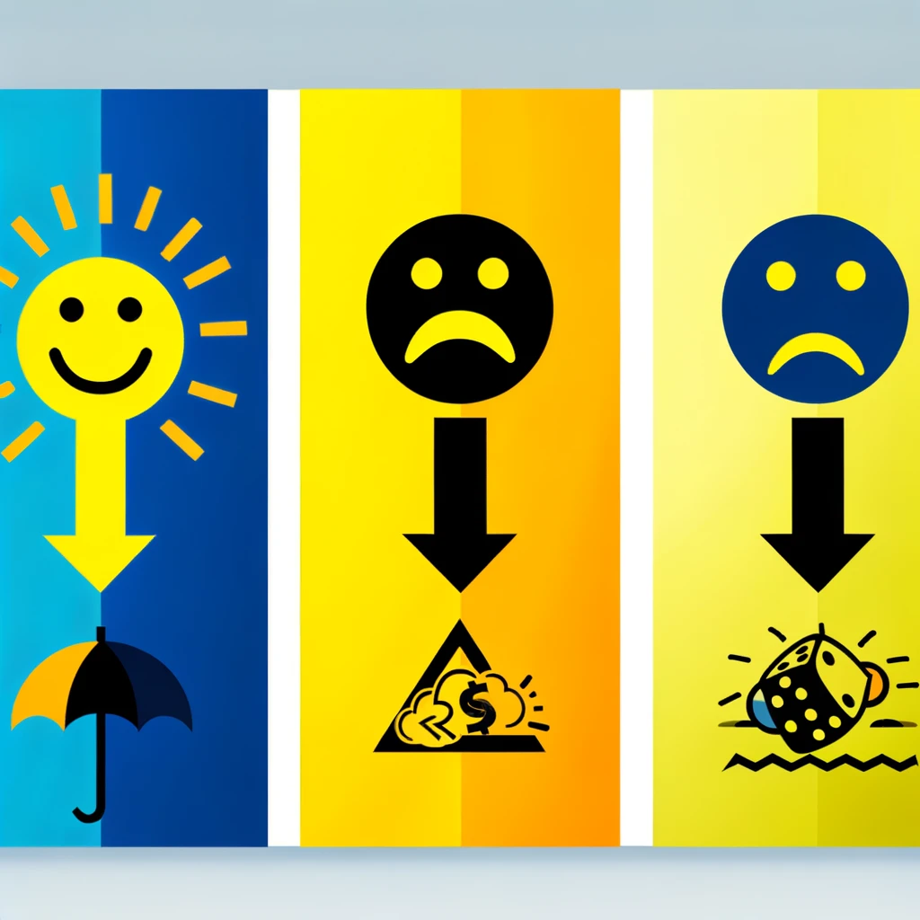
1. Sentiment Word Lists
Objective
Read-in the positive words list and negative words list.
In order to train the model to recognize 'positive' and 'negative' sentiments, the Loughran-McDonald Master Dictionary with Sentiment Word Lists data set was used.

Slide 15
1. Sentiment Word Lists (a sample)
Positive
Negative
advantages
diligently
enhancement
innovator
positively
creative
lucrative
collaboration
aberrant
disruption
malfunction
omission
prosecute
severity
undermine
wrongdoing

Slide 16
2. Building ESG Dictionaries
Objective and Application:
Creates specific dictionaries to identify ESG-related discussions within annual reports
They will be used to detect and analyze ESG-related discussions in corporate documents
Process Overview:
Preparation:
Collect and preprocess textual content from designated ESG and non-ESG libraries
Location Name Removal: NLP is used to exclude geographical entities (cities, states, countries) to focus on thematic content
Dictionary Construction (in the next slide)

Slide 17
2. Building ESG Dictionaries
Dictionary Construction:
STEP 1: TOKENIZATION
STEP 2:
FREQUENCY ANALYSIS
Break down preprocessed texts into tokens (words or phrases)
Identify and count occurrences of each token
STEP 4:
FINAL DICTIONARIES
STEP 3: FILTERING NON-ESG CONTENT
Compile unique, category-specific dictionaries for Environmental, Social, and Governance themes
Remove common tokens found in non-ESG libraries to ensure ESG dictionaries' relevance

Slide 18

3. Identifying ESG Discussions
A Three-Sentence Moving Window
Analyzes the text three sentences at a time.
This window size is chosen to ensure that the analysis captures enough context around keywords or phrases related to ESG topics without being too narrow or too broad.
Allows for a more nuanced detection of ESG discussions, considering the immediate context in which terms are used.
Category-Specific Analysis
The above process is repeated for each ESG category (Environmental, Social, Governance).
For each category, we look for occurrences of terms from predefined dictionaries specific to that category.

Slide 19
4. Quantifying Discussions and Calculating Points
Step 1: (In each window) Positive and Negative Word Counts
For each three-sentence window, we count how many words are positively/negatively associated with ESG topics.
This involves our predefined lists of positive and negative word lists tailored to the context of ESG discussions.
Step 2: (In each ESG Category) Derivation of Total Points for E, S, and G
We calculate a "total points" score for Environmental, Social, and Governance discussions separately.
Total Score = Positive Score - Negative Score
This score reflects the overall sentiment or stance of the document toward each ESG category.
Step 3: Normalization for Cross-File Comparison:
Since the documents may vary significantly in their volume of ESG discussions, we normalizes the total points by the total number of sentiment words to convert the score into a percentage.
This normalization allows for a fair comparison across documents of different lengths and densities of ESG discussions.

Slide 20
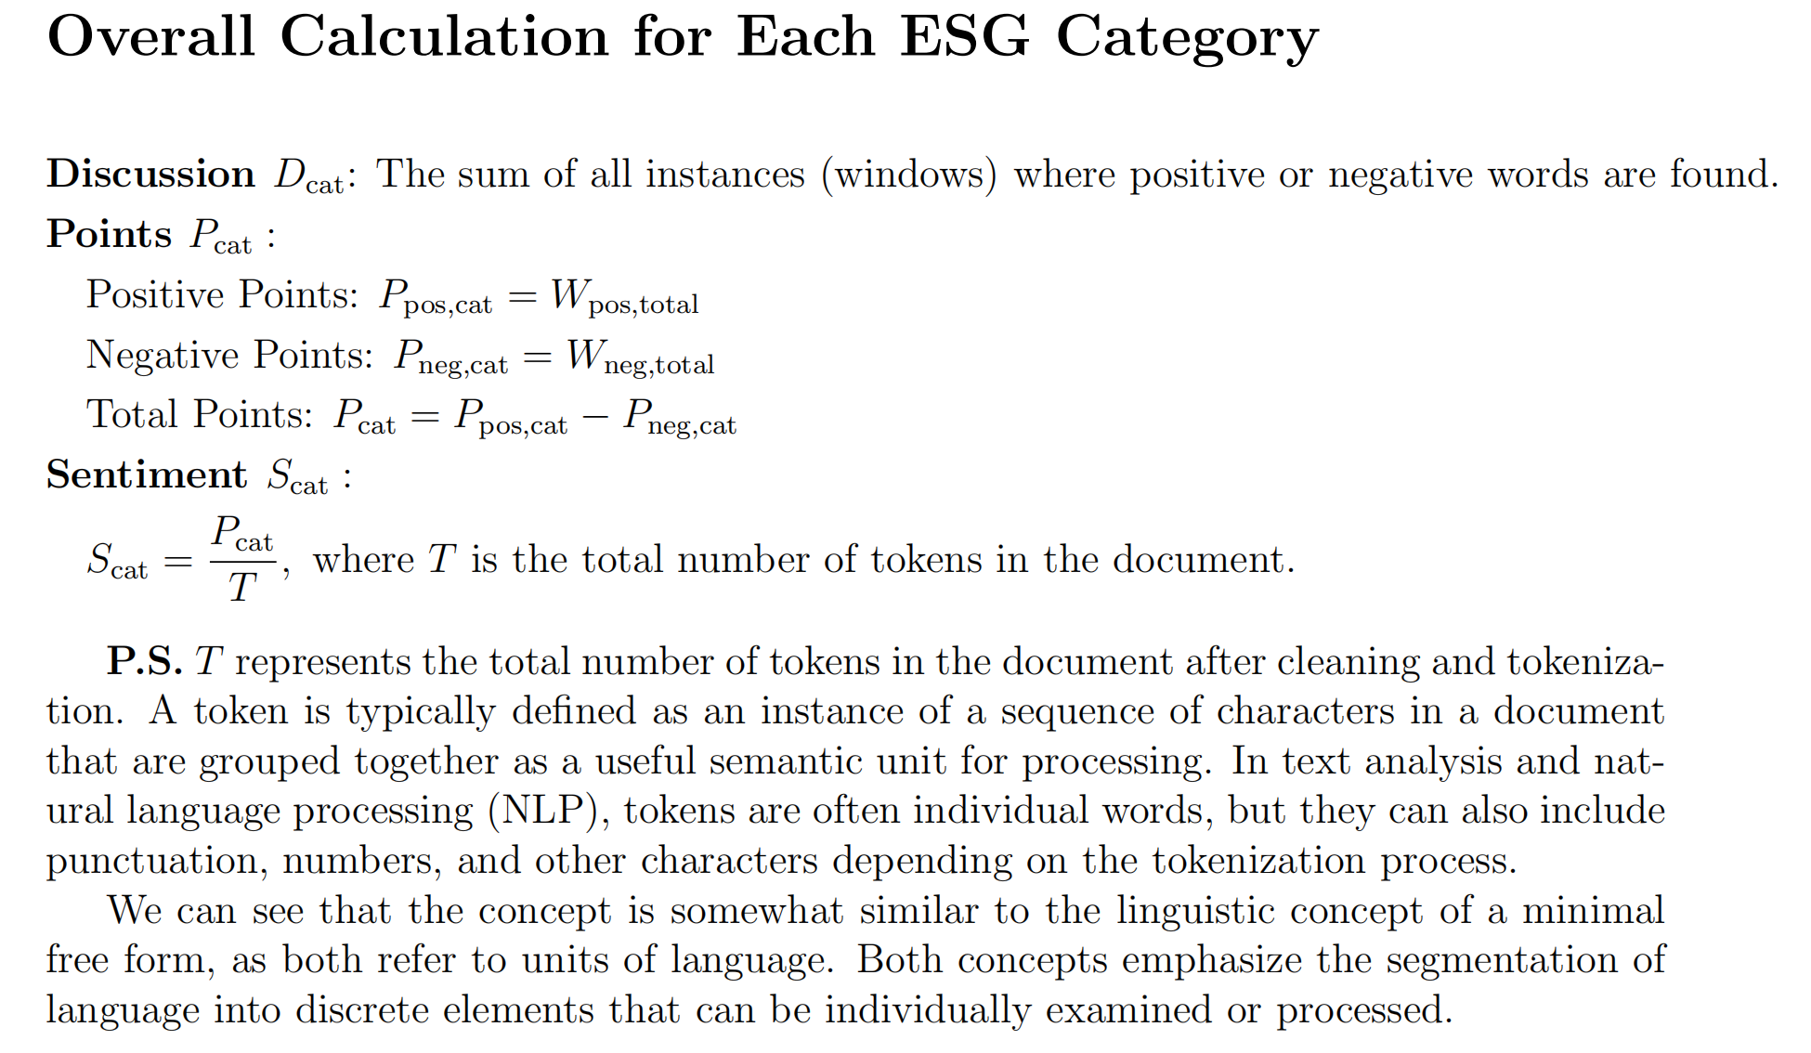
4. Quantifying Discussions and Calculating Points

Slide 21
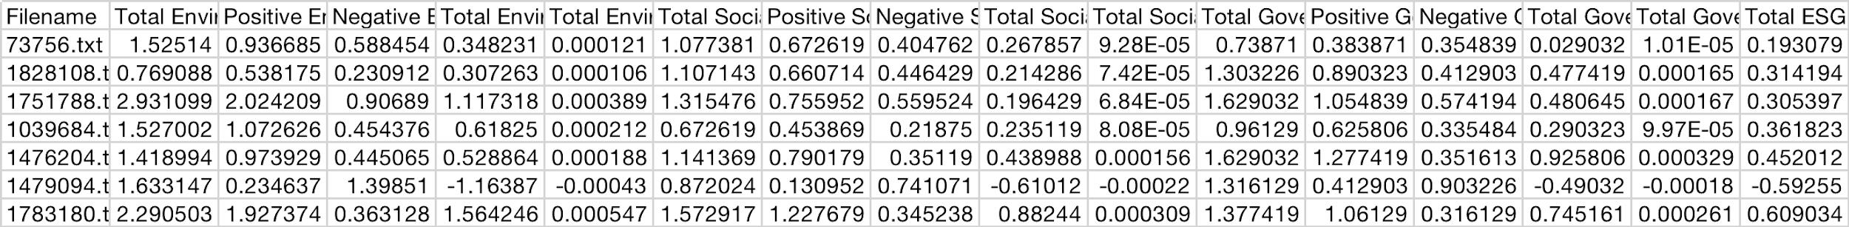
Output
Output Variables
Total Environmental/Social/Governmental Discussion
Total E/S/G Points
Positive E/S/G Points
Negative E/S/G Points
Total E/S/G Sentiment
Total ESG Sentiment

Slide 22
04
Regression & Visualization

Slide 23
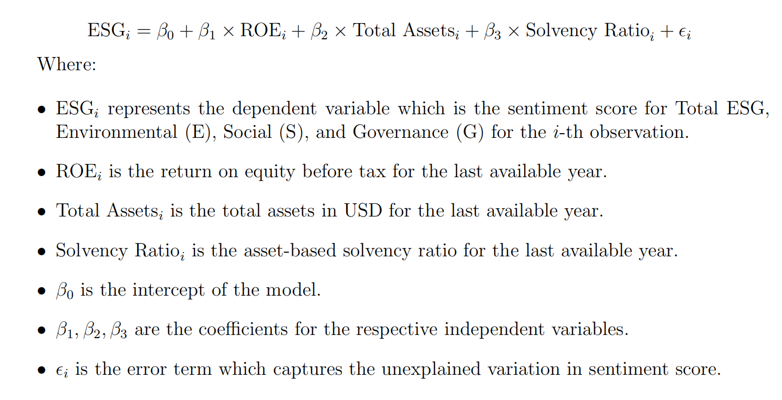
Regression Analysis
Four
Regressions
After gaining esg sentiment score, we try to find the relationship between financial metrics and esg sentiment score, in order to find whether the company are inclined to conceal the bad financial performance using positive esg content or inclined to have positive tone in esg content when financial performance is good. Here is our regression model. If company are trying to conceal, the coefficient of beta are expected to be negative.
Notes:
After gaining esg sentiment score, we try to find the relationship between financial metrics and esg sentiment score, in order to find if the company are inclined to conceal the bad financial performance using positive esg content. If company are try to conceal, the coef of beta are expected to be negative. Here is our regression model.

Slide 24
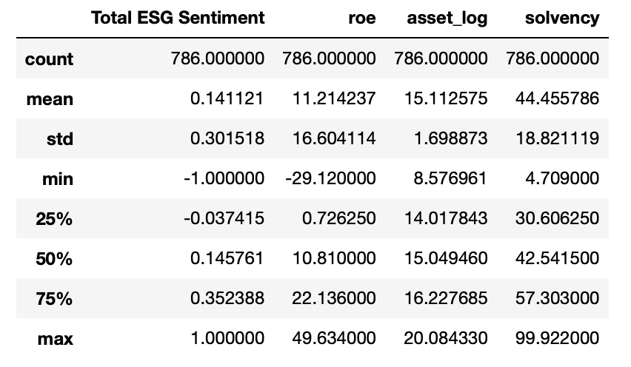
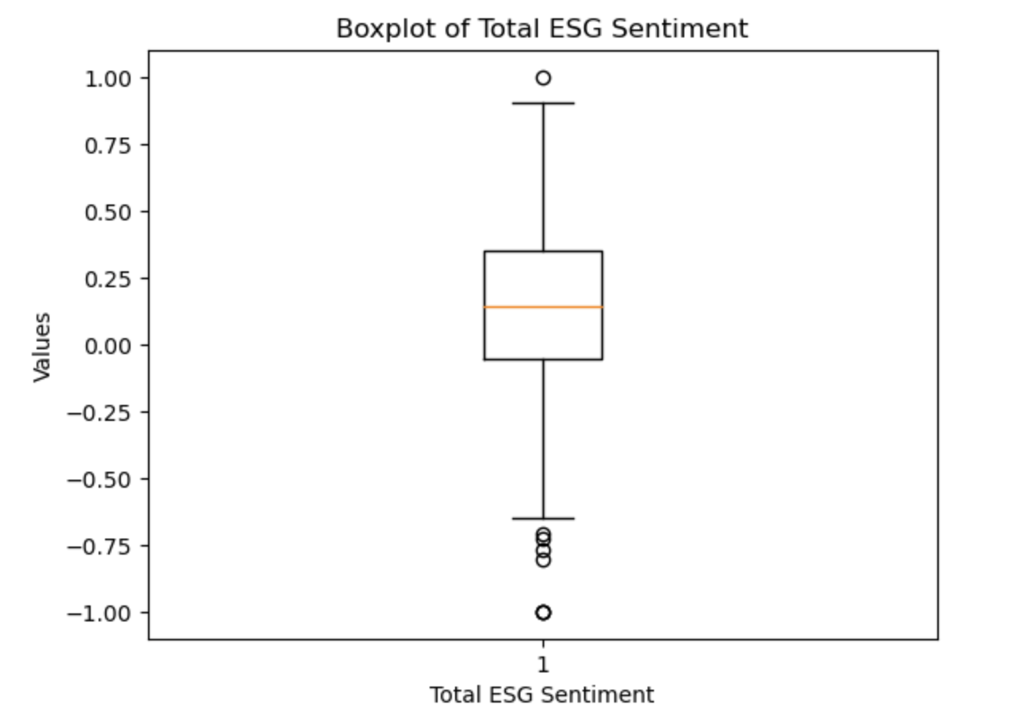
Descriptive Statistics
The total ESG sentiment score are within the range of -1 and +1, with a mean of 0.139. Mean of the esg sentiment of all sample companies is positive, implying that most companies are trying to report positive ESG content, which is within our expectations. But the variation of sentiment is very large for reports.
Notes:
Mean of the esg sentiment of all sample companies is positive, implying that most companies are trying to report positive ESG content, which is within our expectations. But the variation of sentiment is very large for reports.

Slide 25
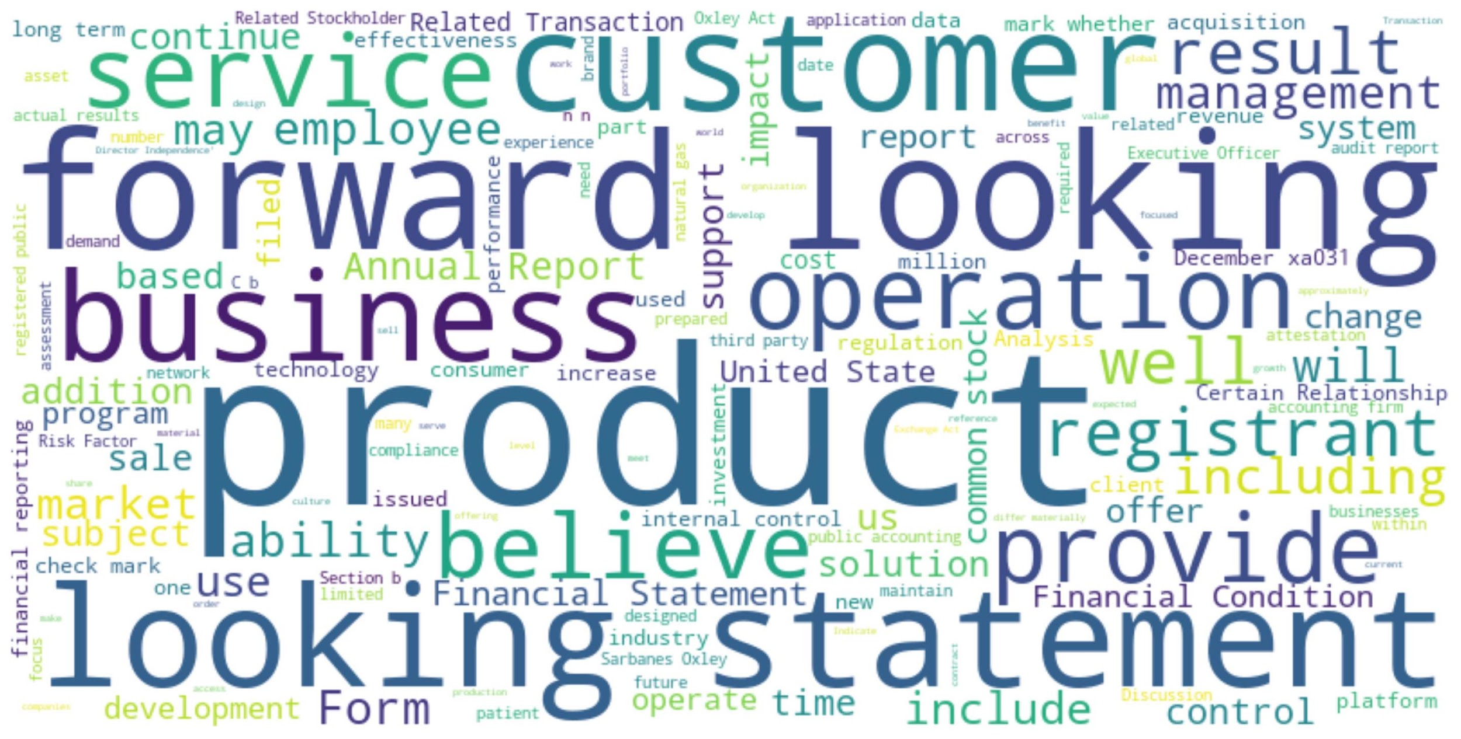
Notes:
We also made wordcloud to illustrate the word frequency of esg content

Slide 26
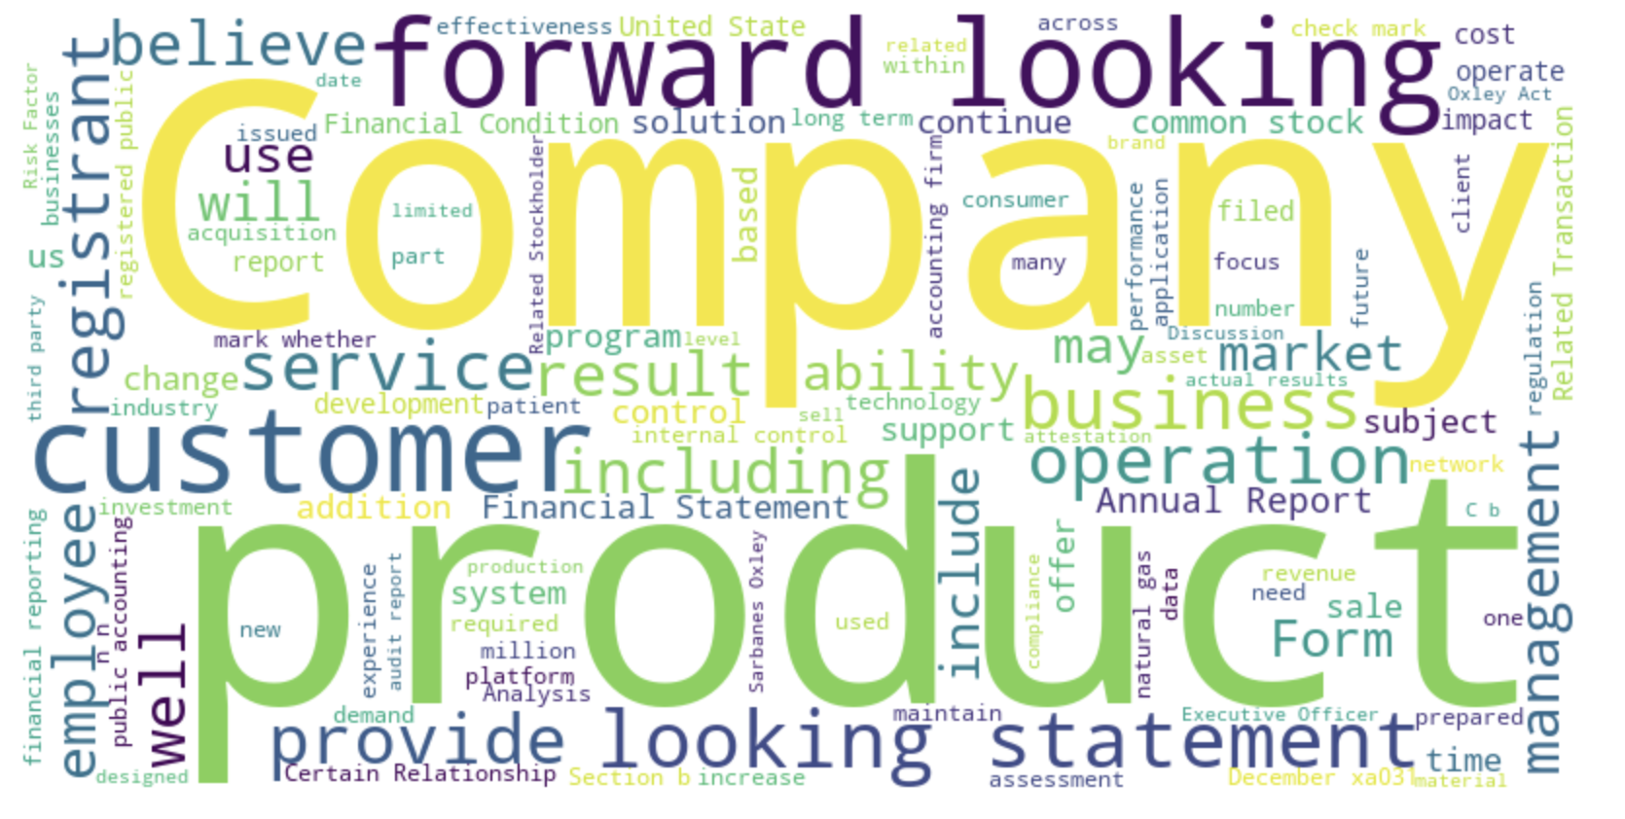
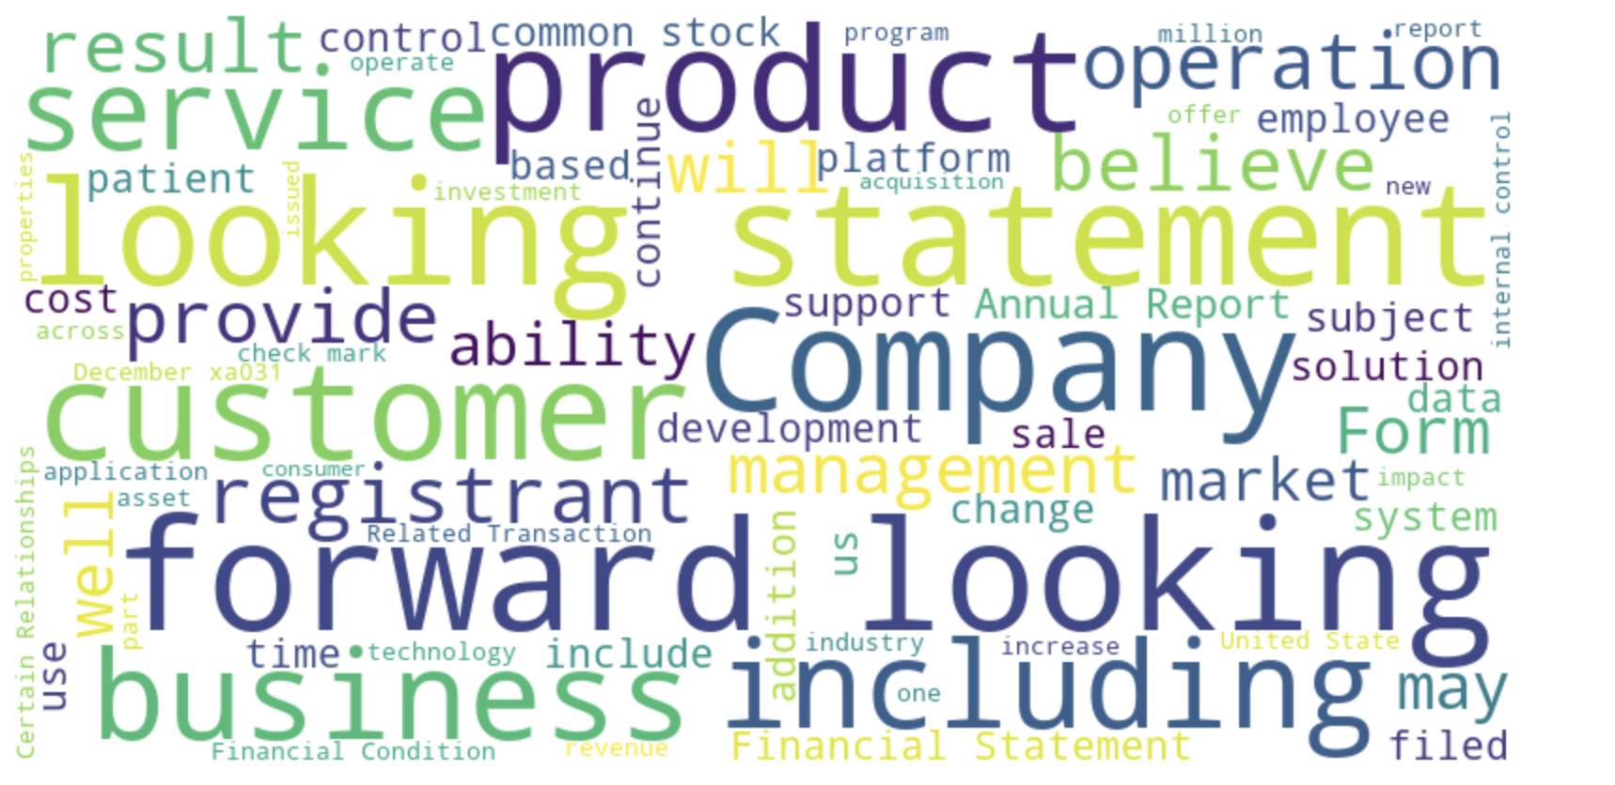
Notes:
It is evident that compnies with ROE that ranked last 50% may have more emphsis on foward looking, as we can see from the size of forward looking is larger

Slide 27
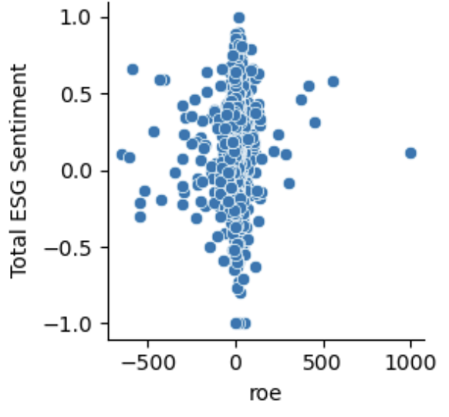
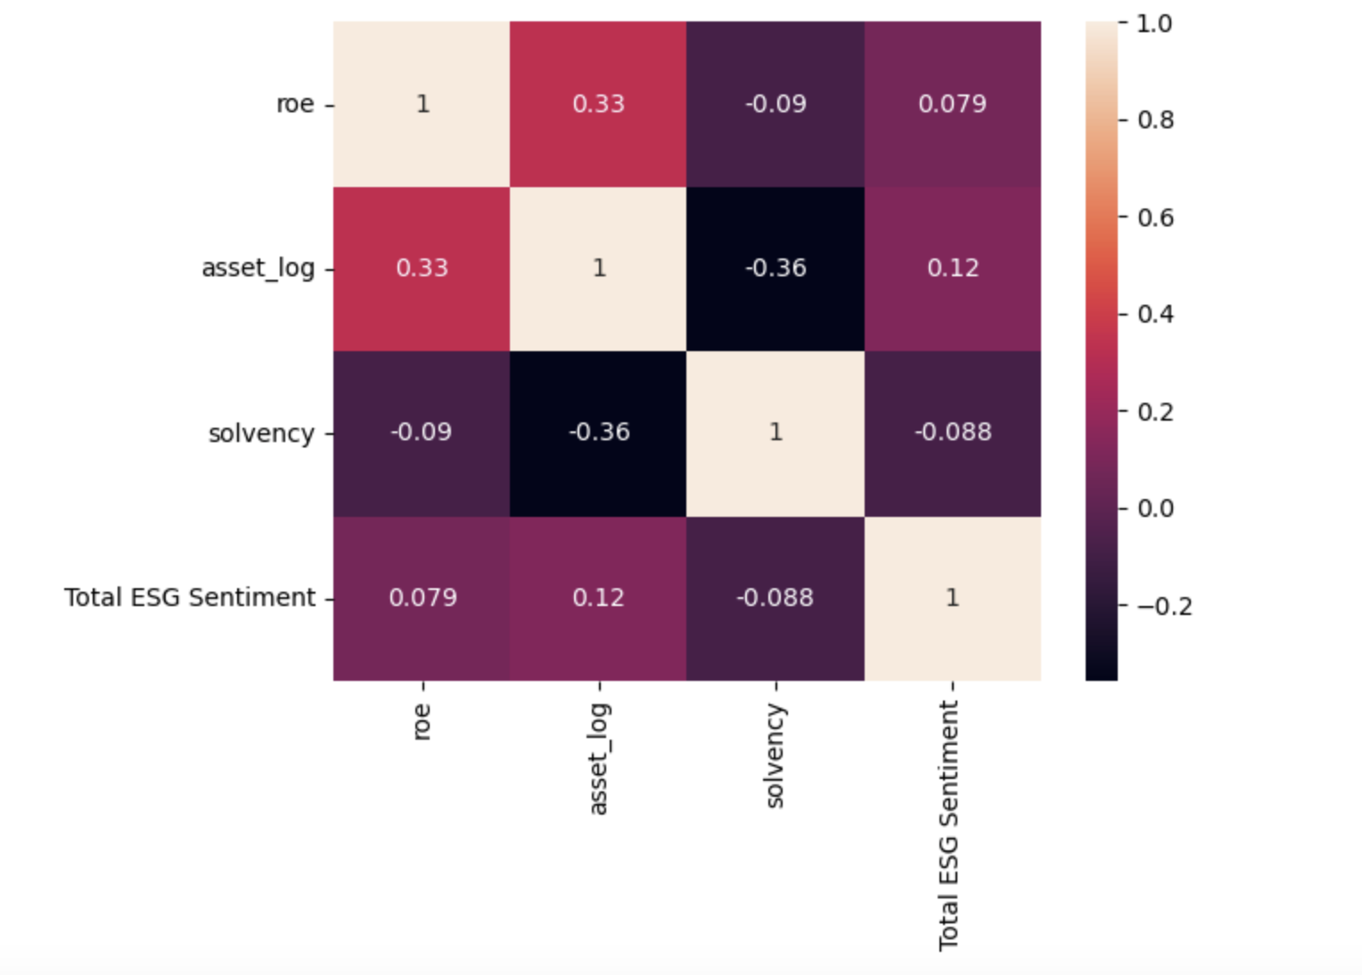
Scatter Plot & Heat map
If we only look roughly look at the correlation coefficient between independent variables, the result seems not that good, there is no evident pattern of positive nor negative relationship in this scatter plot. When we look at the heatmap, we can get a roughly positive relationship between ROE and Total ESG sentiment. But we still cannot conclude the relationship between esg score and financial metrics. Thus we need to run the regression
Notes:
前期简单看：如果看相关系数，结果不太好，所以需要控制其他变量回归。Heatmap:Roe和esg sentiment微弱正相关
If we only look roughly look at the correlation coefficient between independent variables, the result seems not that good, there is no evident pattern of positive nor negtive relationship in this scatter plot. When we look at the heatmap, we can get a roughly positive relationship between ROE and Total ESG sentiment. But we still cannot conclude the relationship between esg score and financial metrics. Thus we need to run the regression

Slide 28
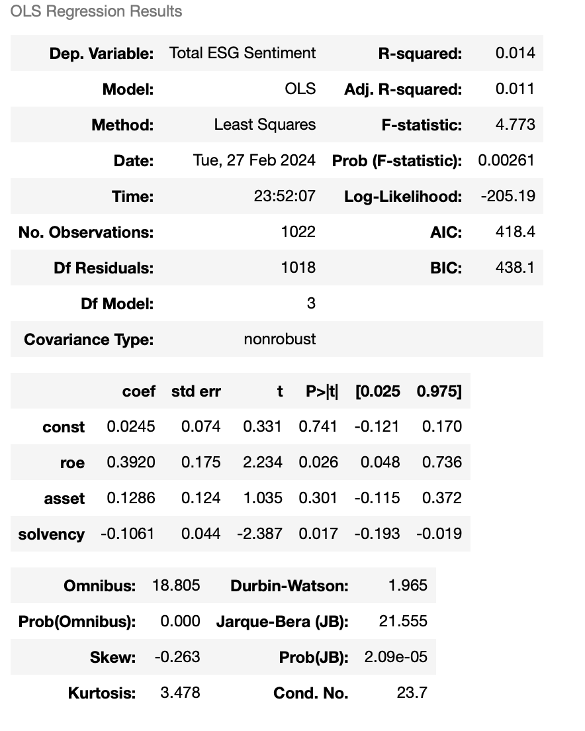
Regression Results - I
Y: Total ESG Sentiment
Adj. Rsquared: 0.011, similar to the Total ESG, the model explains about 1.3% of the variability. Coefficients: The coefficient of ROE is statistically significant at the 5% level (pvalues < 0.05).
The regression of total ESG score on return on equity shows a positive relationship, and the positive coefficient is statically significant. Thus we can conclude that the company are generally not inclined to conceal the bad financial performance using positive ESG content. If the overall financial performance is good, companies tend to report financial performance in a more positive tone.
Notes:
The regression of total ESG score on return on equity shows a positive relationship, and the positive coefficient is statically significant. Thus we can conclude that the company are generally not inclined to conceal the bad financial performance using positive ESG content. If the overall financial performance is good, companies tend to report financial performance in a more positive tone.

Slide 29
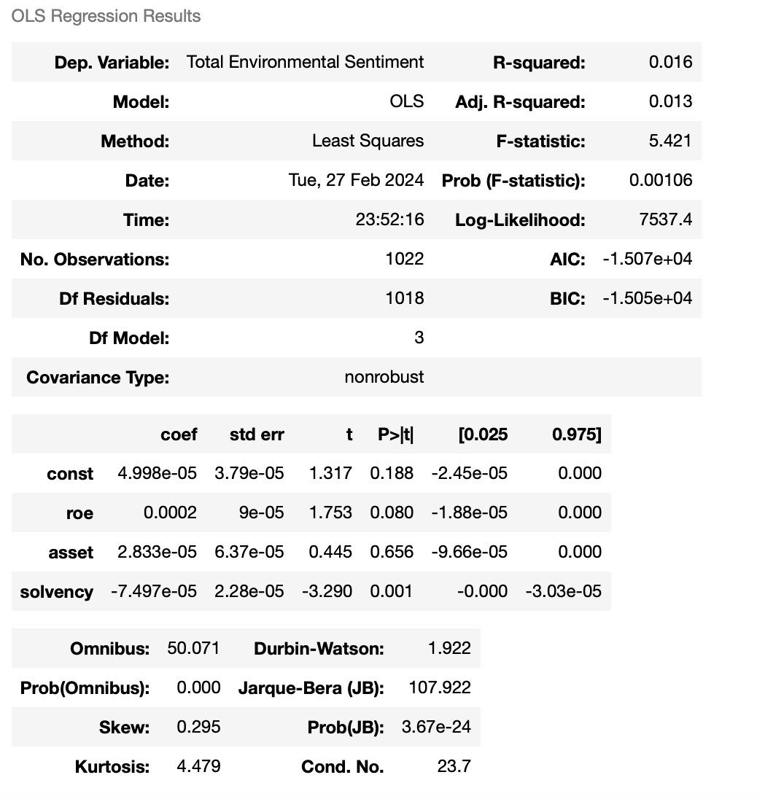
Regression Results - II
Y: Total E Sentiment
Adj. Rsquared: 0.013, similar to the Total ESG, the model explains about 1.3% of the variability.
Coefficients: coefficient of ROE is significant at the 10% level
The we separately run reg on Environment, S and G score, to show if company have incentive to manipulating words in separate category to conceal the bad performance. Overall, if the overall financial performance is good, companies tend to report financial performance in a more positive tone.
Notes:
The we separately run reg on Environment, S and G score, to show if company have incentive to manipulating words in separate category to conceal the bad performance. Overall, if the overall financial performance is good, companies tend to report financial performance in a more positive tone.

Slide 30
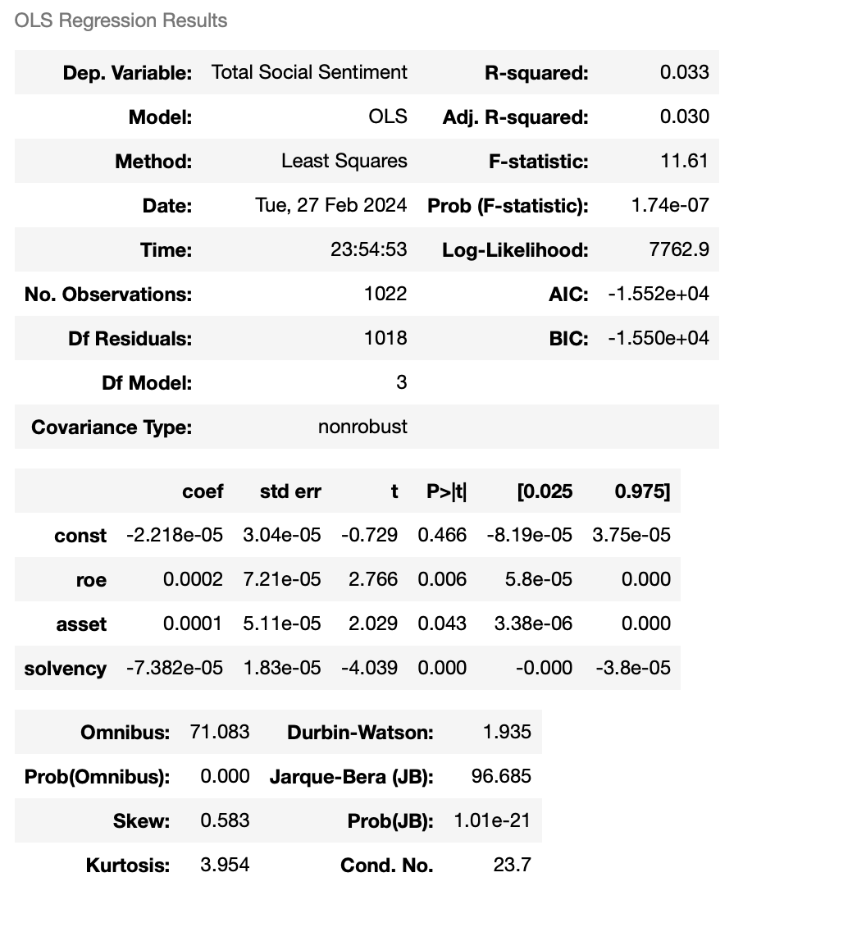
Regression Results - III
Y: Total S Sentiment
Adj. Rsquared: 0.030, a bit higher explanatory power, explaining 3.0% of the variability in Total Social Sentiment.
Fstatistic: 11.61 with a pvalue of 1.74e07, indicating that the regression model is highly statistically significant.
Coefficients: coefficient of ROE is significant at the 1% level

Slide 31
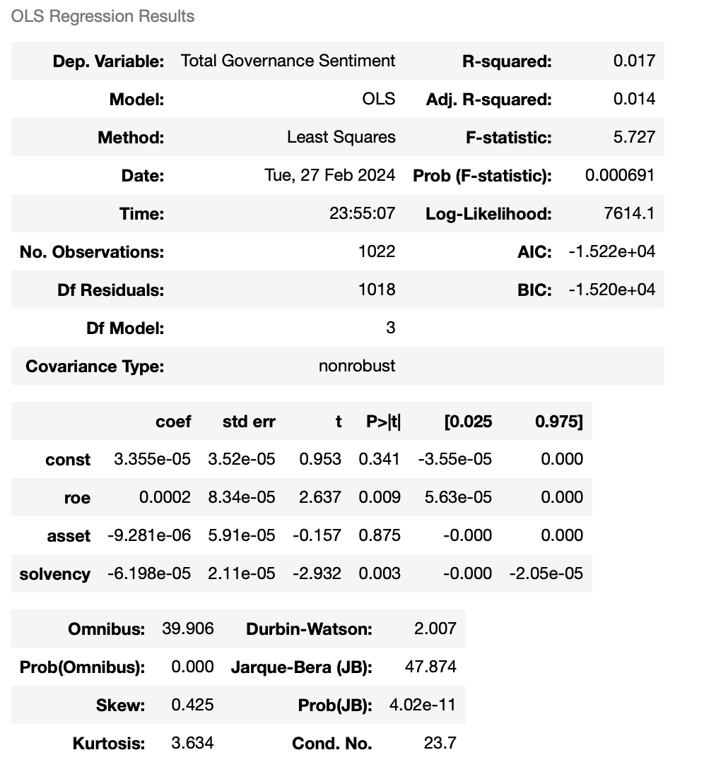
Regression Results - IV
Y: Total G Sentiment
Adj. Rsquared: 0.014, similar to Total ESG and Environmental models.
Fstatistic: 5.727 with a pvalue of 0.000691, indicating a statistically significant model.
Coefficients: Like the Total Environmental Sentiment, no coefficients are significant at the 5% level, although the solvency ratio is close with a pvalue just above 0.003.

Slide 32
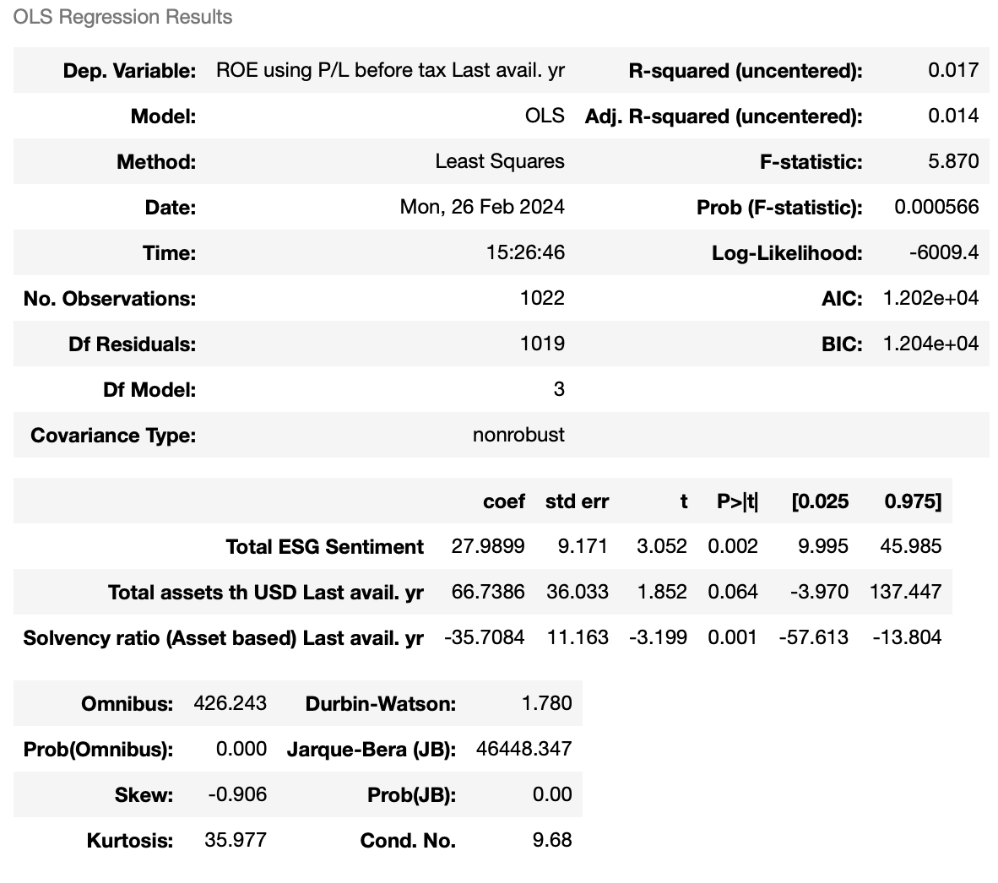
Regression Results - IV
Y:ROE
Adj. Rsquared: 0.017, similar to Total ESG and Environmental models.
Fstatistic: 5.87 with a pvalue of 0.02, indicating a statistically significant model.
Coefficients: The total ESG Sentiment coefficients is significant at the 5% level

Slide 33
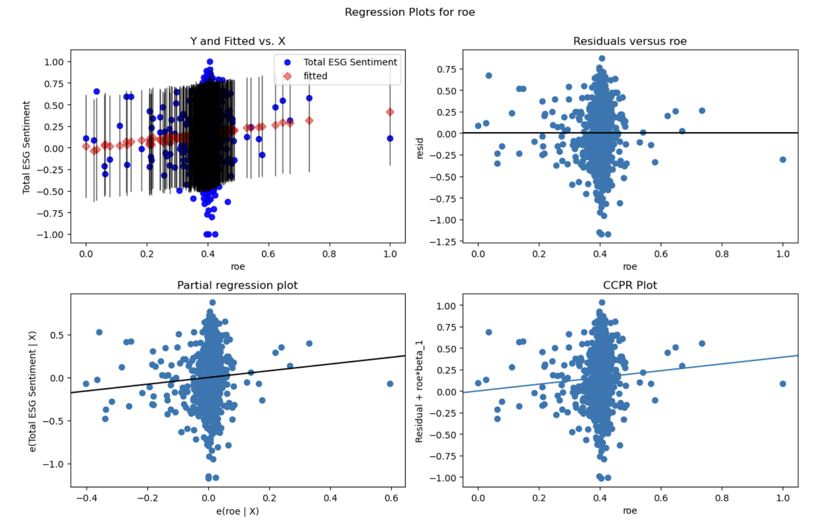
Residual Analysis
We can see from the regression plot and residual analysis plot that there is still some outliers in our graphs, which may require us to further process our data.
Notes:
还有outlier，回归还有问题，后面会进一步处理 We can see from the regression plot and residual analysis plot that there is still some outliers in our graphs, which may require us to further process our data.

Slide 34
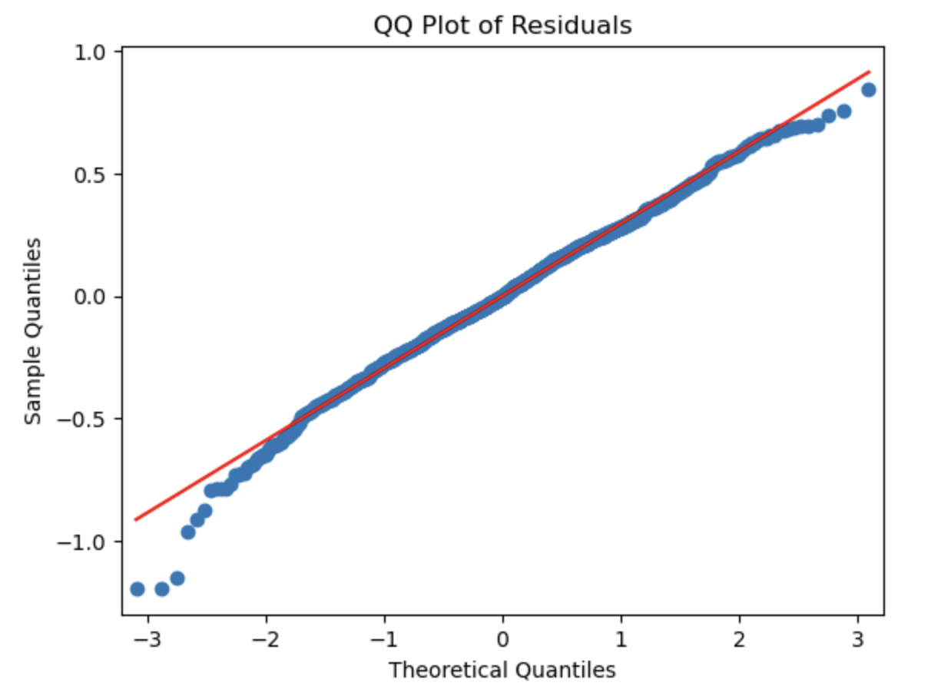
QQ Plot of Residuals
The residual analysis shows that the normality assumption of estimator did not break.
Notes:
残差分析结果：OLS estimator assumption没有break，OLS estimator可信 The residual analysis shows that the normality assumption of estimator did not break.

Slide 35
THANK YOU
Q&A

